Slide 1
In-class Exercise 10 - Morphology
Dhiren Gupta
-800902466

Slide 2
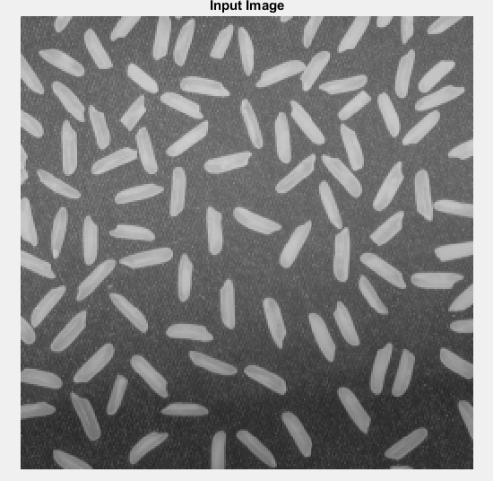
Input Image

Slide 3
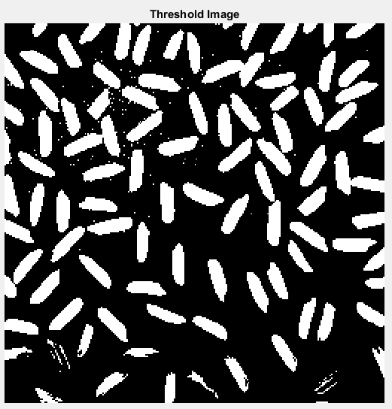
Threshold Image

Slide 4
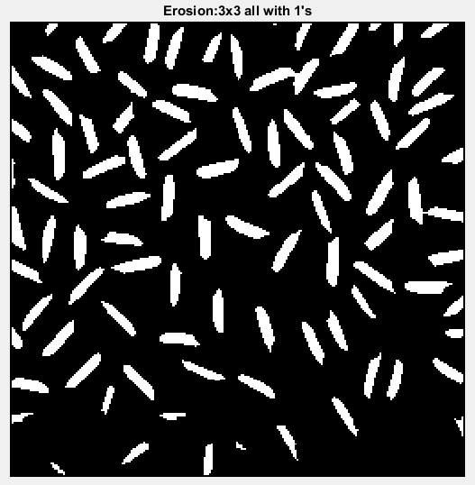
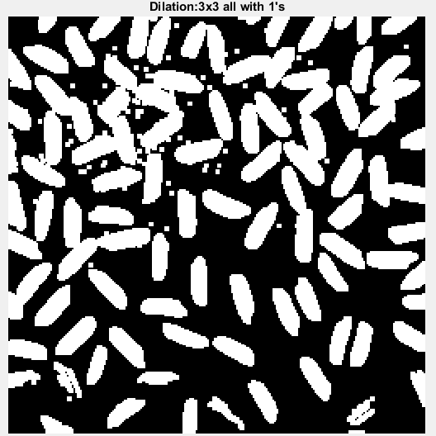
Output:3x3 structuring element (all with 1's)
Erosion
Dilation

Slide 5
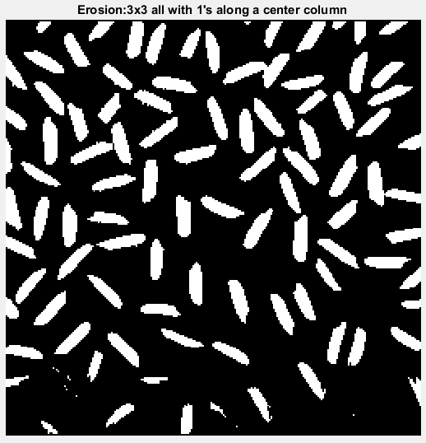
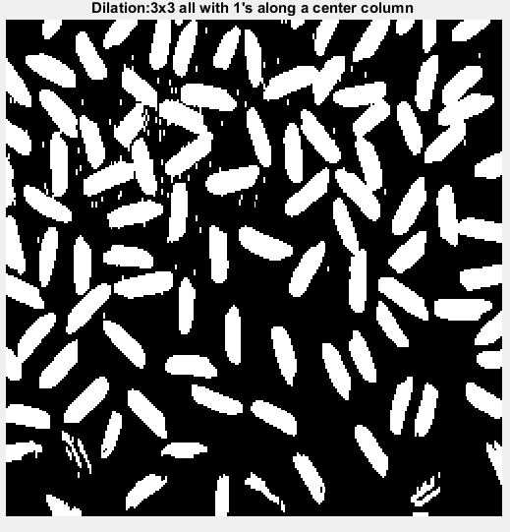
Output:3x3 structuring element (Center with 1's)
Erosion
Dilation

Slide 6
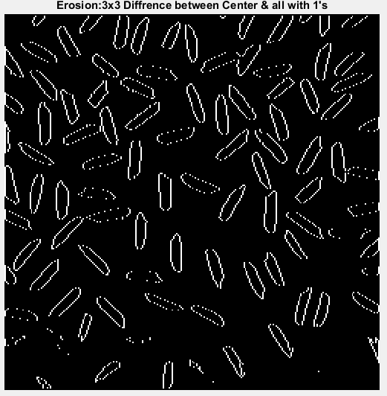
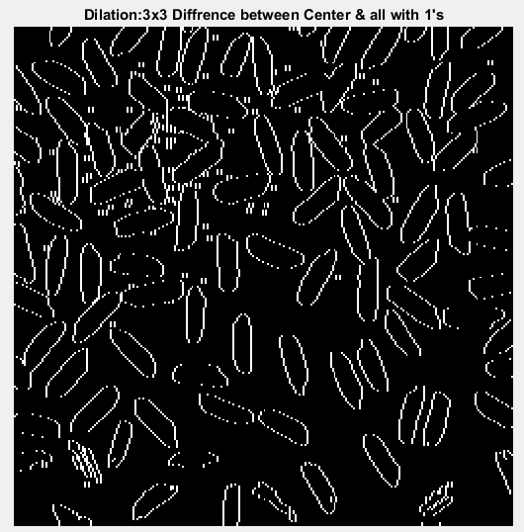
Difference for 3x3 Structure
Erosion
Dilation

Slide 7
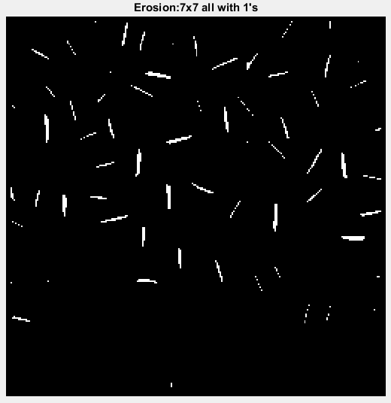
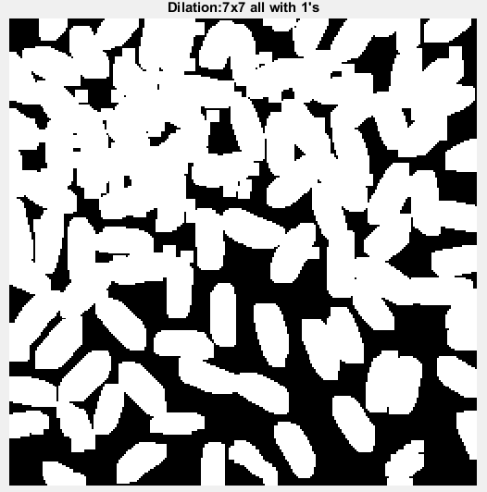
Output:7x7 structuring element (all with 1's)
Erosion
Dilation

Slide 8
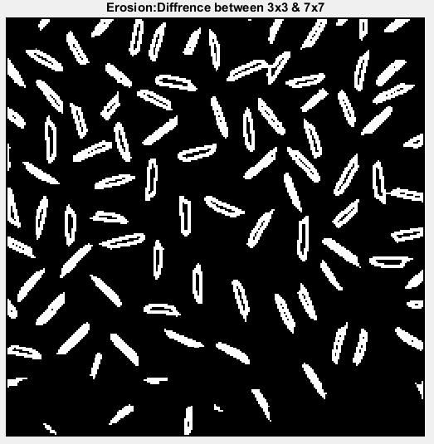
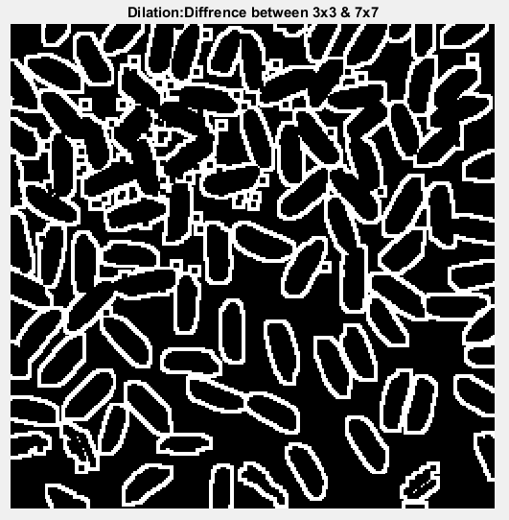
Difference b/w 3x3 and 7x7 Structure
Erosion
Dilation

Slide 9
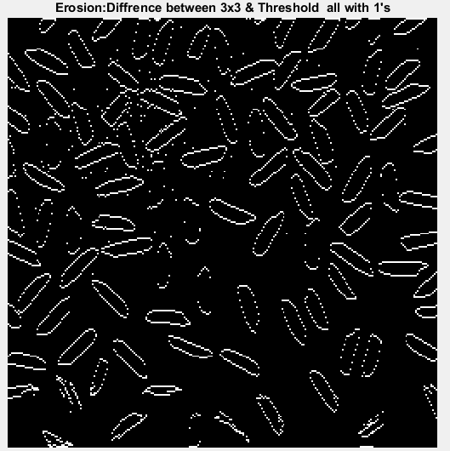
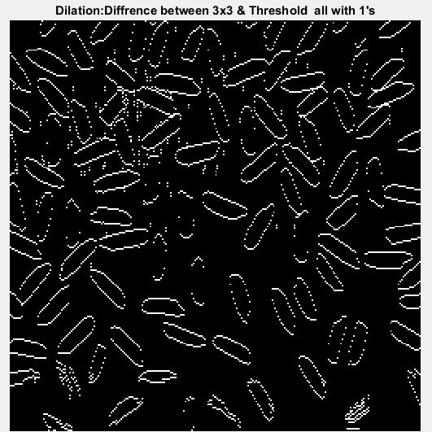
Difference b/w Threshold and 3x3 with all 1’s
Eroison
Dilation

Slide 10
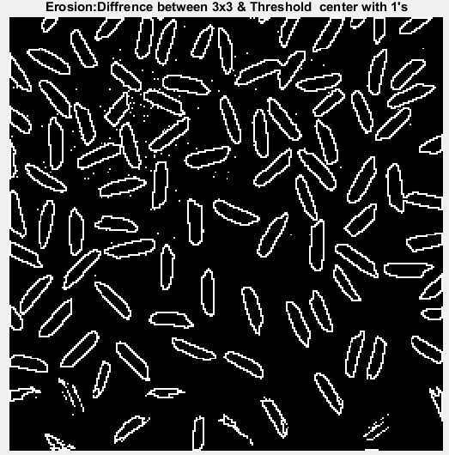
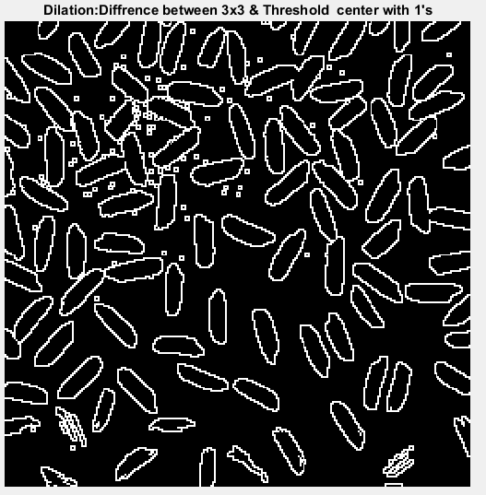
Difference b/w Threshold and 3x3 with Center 1’s
Eroison
Dialtion

Slide 11
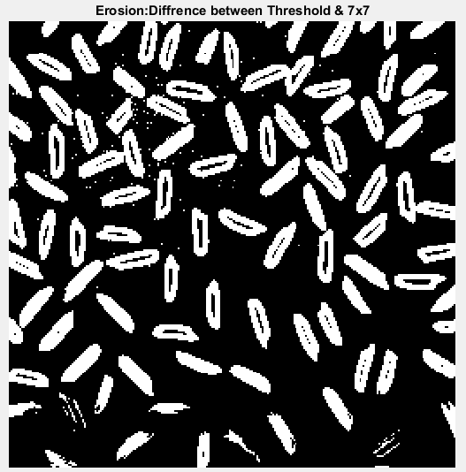
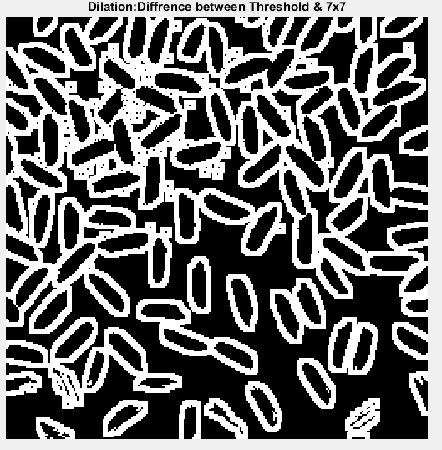
Difference b/w Threshold and 7x7 with all 1’s
Erosion
Dialtion

Slide 12
Thank You

